Slide 1
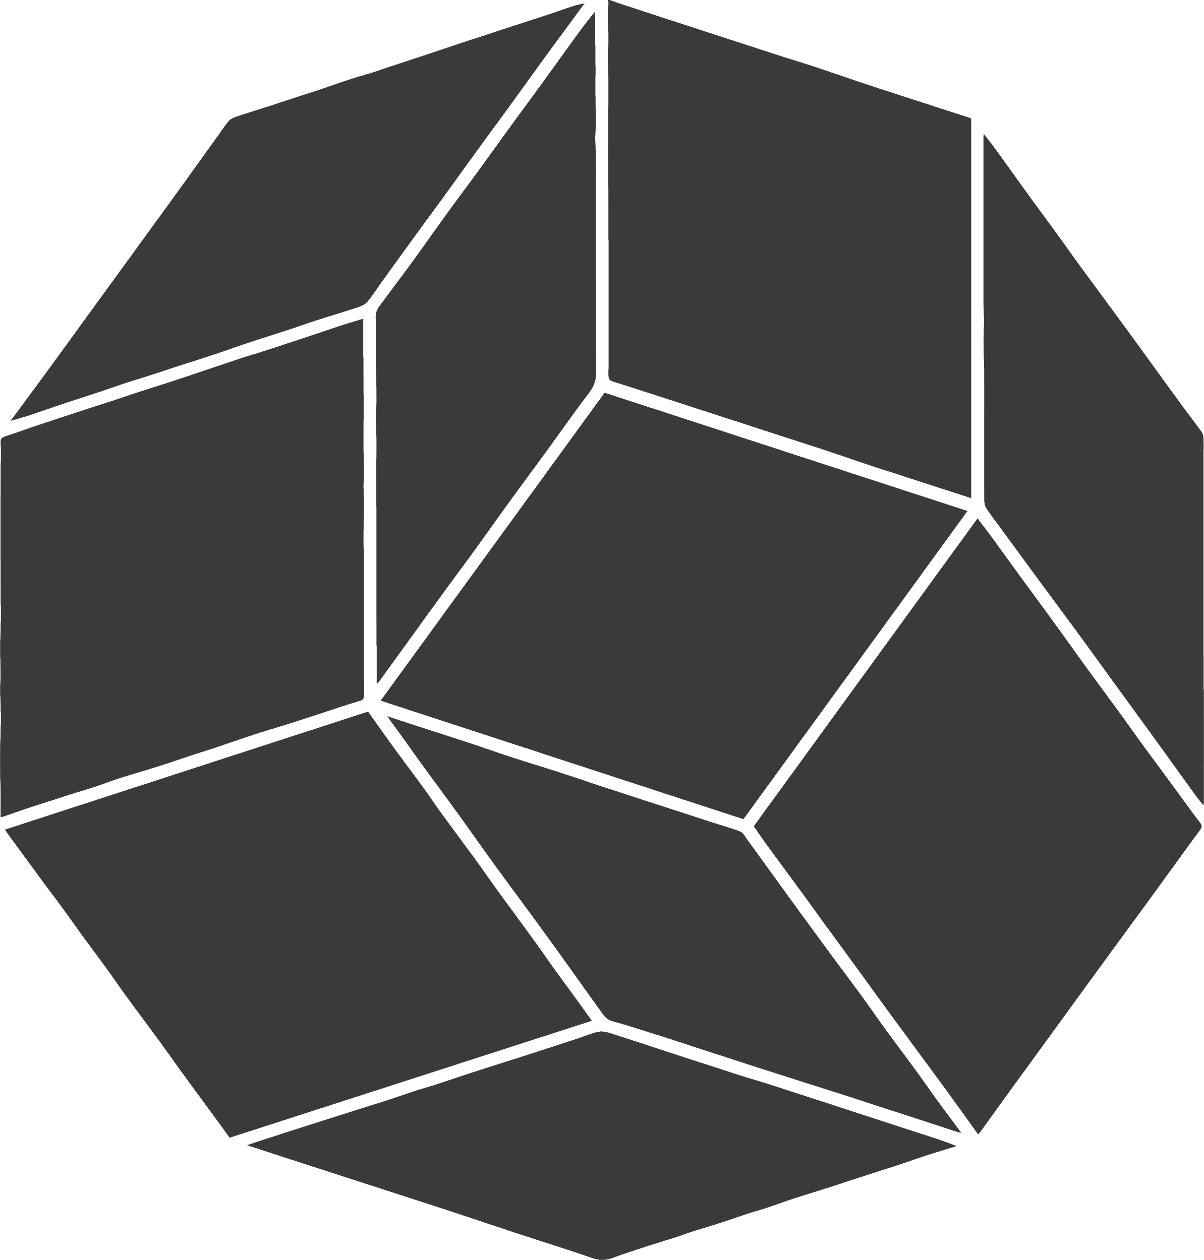


Reparameterizing Distributions on Lie Groups
Luca Falorsi^{1,2}, Pim de Haan^{1,3}, Tim R. Davidson^{1,2}, Patrick Forré¹
University of Amsterdam Aiconic U.C. Berkeley

Slide 2
A Probabilistic Model of The World
Generally, in machine learning we aspire to model the world around us
We attempt to infer latent structure responsible for observed events
Unfortunately, our observations can be incomplete and noisy
Hence, we utilize a probabilistic approach to allow for imperfect predictions

Slide 3
Variational Inference
Given: Observations (X) Assumed: Latent Structure (Z)
We would like to infer the posterior over latent variables given observations, p(Z|X)
Deep Learning: Powerful to learn arbitrary functions
Bayes Rule: intractable in practice
Alternative: Variational Inference (VI)
transforms inference task into an optimization problem
find distribution q(Z), that best approximates true posterior
Reparameterization trick crucial to enable VI in DL
Z
X

Slide 4
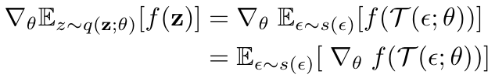
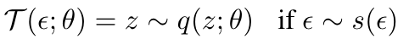
Reparameterizable distributions
where , if
We want to:
Take unbiased, low variance gradients with respect to the distribution’s parameters
We need to be able to:
Take samples of the distribution by first sampling a simple distribution independent on the parameters and then transforming it into the target distribution
Compute the density (often useful for computing KL using MC estimates)

Slide 5
So, is reparameterizing distributions solved?
No general trick to reparameterize arbitrary density
In recent years much research has been done on extending the class of reprametrizable densities:
Normalizing Flows (Rezender & Mohammed 2014)
Acceptance Rejection Sampling (Naesseth et al. 2017)
Implicit Reparameterization (Figurnov et al. 2018)
However almost all past work assumes a ‘flat’ Euclidean space
Notes:
Normalizing flows
Accept/reject
Implicit reparameterization

Slide 6

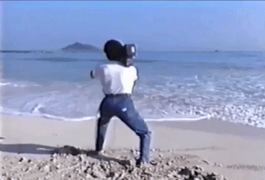
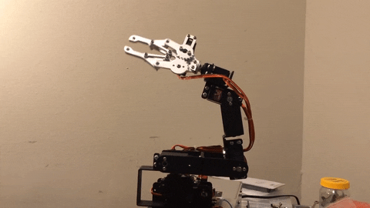
Lie Groups in the Wild
Yet many problems are naturally defined on non-trivial spaces:
Example 1: estimate position and orientation of a Drone
Example 2: infer camera position and orientation
Example 3: maximum entropy reinforcement learning on a Robotic Arm
Example 4: inference of an orthogonal matrix in a Bayesian Neural Network
All of the above can be described in terms of ‘Lie Groups’ !

Slide 7
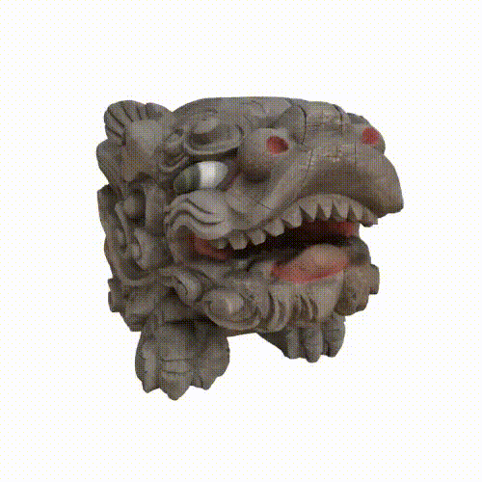
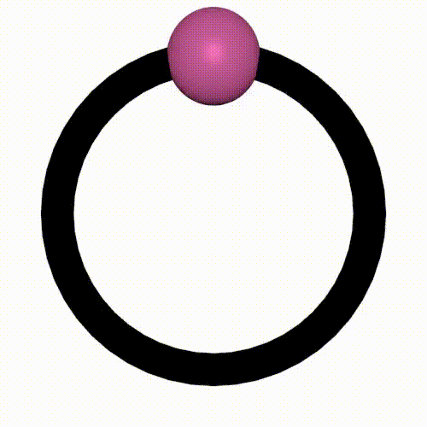
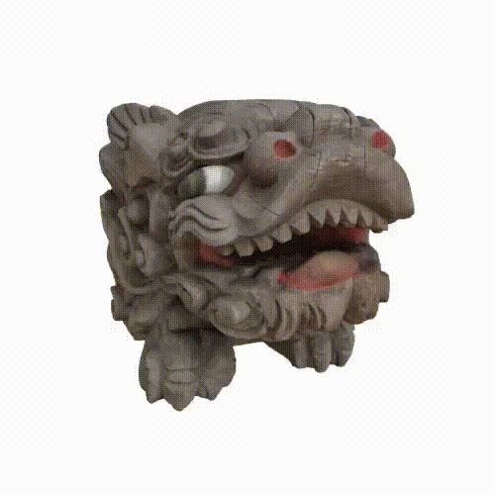
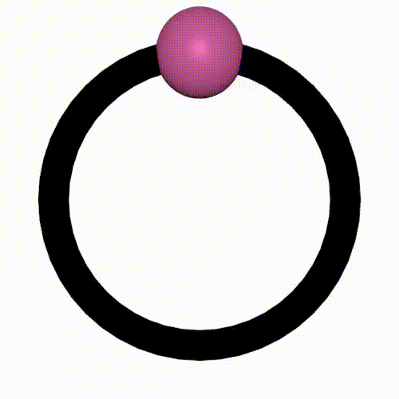
What is a Lie Group
Manifold: locally Euclidean, but globally non-trivial
Lie Groups, manifolds with group structure:
The elements of the space can operate on the space itself by group multiplication
Very useful construct to describe changes of objects over time!
Notes:
fundamental building block in many subbranches of Physics (Standard Model), Mathematics (Langdon Program), Control Theory
OLD
Many latent variables restricted to a specific subspaces called ‘manifolds’
Manifold: locally Euclidean, but globally non-trivial
Lie Groups describe a category of manifolds with special properties
Very useful construct to describe changes of objects over time!

Slide 8
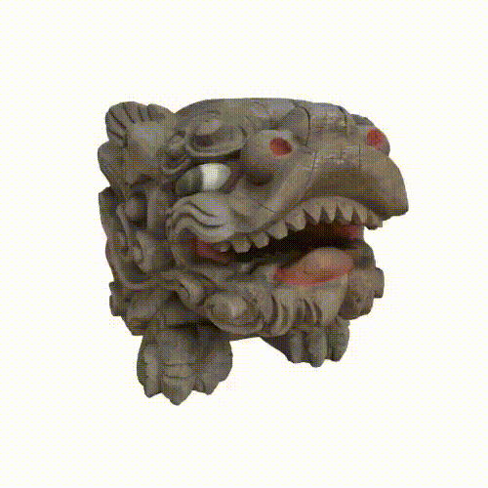
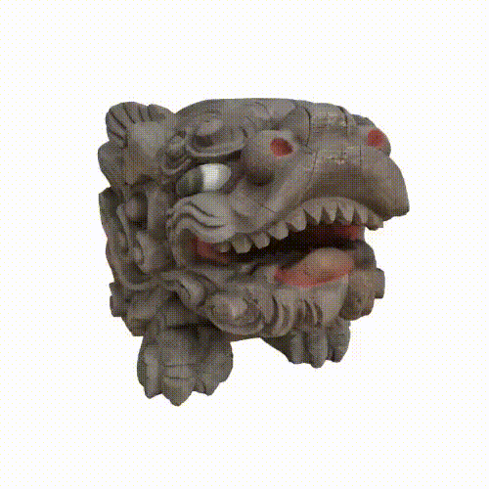
Lie Group Examples
SO(2)
SO(3)
SE(3)

Slide 9
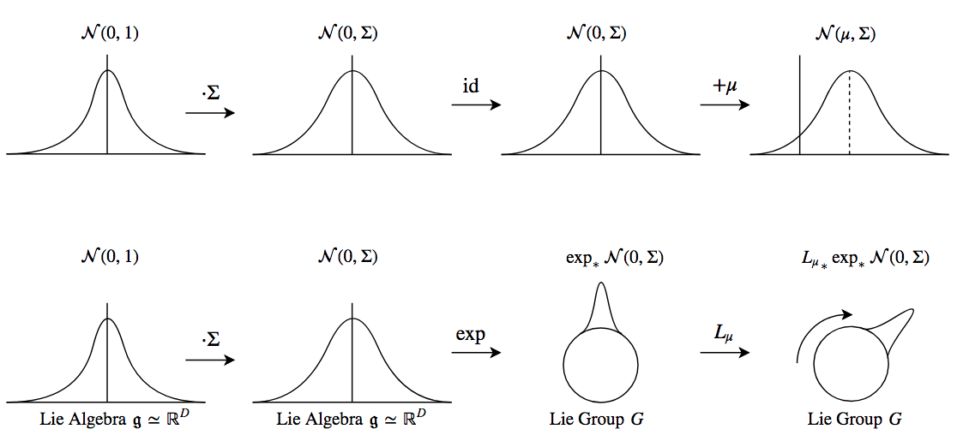
Gaussian Reparametrization
Location-scale reparameterization trick
Sample from standard Gaussian
Change scale
Change location by using translation operation
Notes:
Note in step (B): i. We do not change the underlying space, ii. We have a bijective mapping
OLD:
Can consider ℝ^{N} under addition as a Lie group with Lie algebra ℝ^{N} itself
Sample from univariate Gaussian
Change scale (add ‘noise’)
Apply exponential map (Identity)
Change location by using Group action (addition in this case)

Slide 10
Reparameterize Lie Groups
mod 2π
?
?
+θ mod 2π
Notes:
Note in step (B): i. We do not change the underlying space, ii. We have a bijective mapping
Note: using a Gaussian as the base distribution is not a requirement, but a simplification

Slide 11
Reparameterize Lie Group
Reparametrize a density in Euclidean space:
Tangent space at group identity: Lie algebra 𝖌 ≃ ℝ^{D} [SO(2): ℝ]
Wrapping the algebra to the Group:
Exponential map: exp : ℝ^{D} ≃ 𝖌 → 𝒢 [SO(2): mod 2π]
For matrix Lie groups this is the matrix exponential
Moving the distribution on the lie group on a target position:
Action of group on itself by left group multiplication L_{μ}(g) = μ⋅g [SO(2): +θ mod 2π]

Slide 12
Reparameterize General Lie Group:
Reparameterize density in ℝ^{N}
Exponential map
Act by left multiplication

Slide 13
Where does the difficulty ‘Lie’?
Exponential map:
In general non-injective
In some groups can be constant under local variations
Notes:
OLD
The mapping to the mean is called the ‘exponential map’
‘Pushing forward’ the density from Algebra to Lie Group changes the space
Generally, exponential mapping is not injective

Slide 14
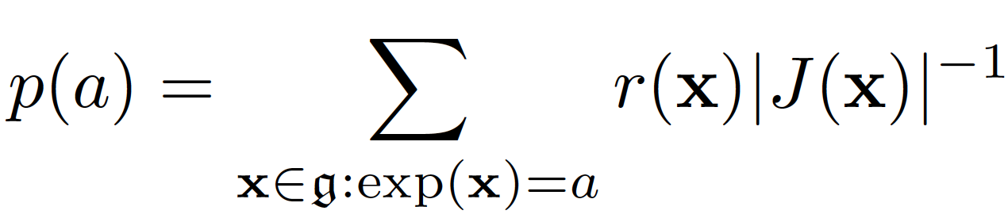
Where does the difficulty ‘Lie’?
Exponential map:
In general non-injective
In some groups can be constant under local variations (in a set of measure zero)
We prove it has a density
Contributions from all pre-image algebra elements
Change of volume
From auto-diff
From Lie Algebra representation
Notes:
OLD
The mapping to the mean is called the ‘exponential map’
‘Pushing forward’ the density from Algebra to Lie Group changes the space
Generally, exponential mapping is not injective

Slide 15
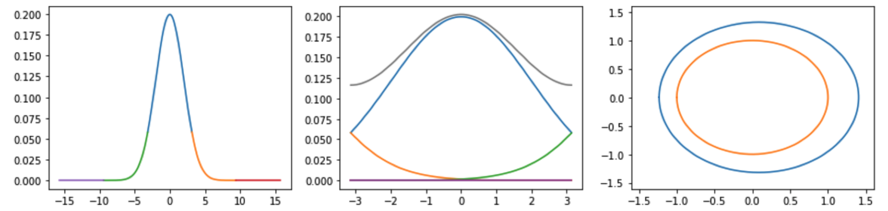
Non-injectivity
Exponential Map
Notes:
OLD
The mapping to the mean is called the ‘exponential map’
‘Pushing forward’ the density from Algebra to Lie Group changes the space
Generally, exponential mapping is not injective

Slide 16
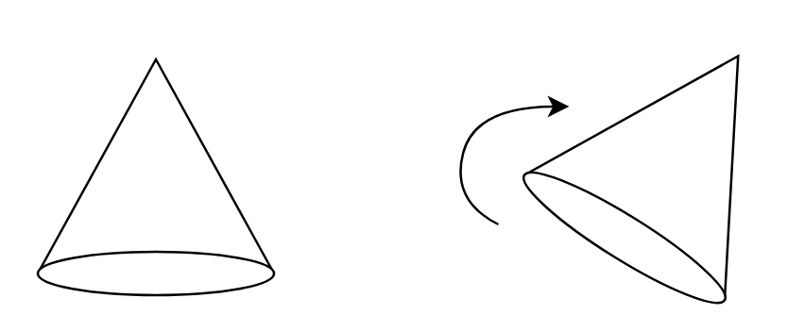
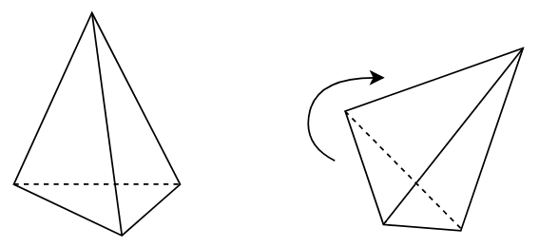
Synthetic example: SO(3)
Group of 3D oriented rotations, describe rotations of static object
Task: given two views of an object, find which rotation(s) relate(s) them
Variational Inference on SO(3)-valued latent
Object (a) has rotational symmetry around one axis
Object (b) has threefold discrete symmetry around one axis
(a)
(b)
Notes:
i.e. the space that covers precily how i move this water bottle around
Many possible a priori rotations possible to end up at same image

Slide 17
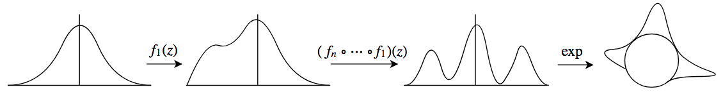
Normalizing Flow
True posterior: circular subgroup / discrete subgroup (order 3)
Multi-modal distributions needed:
Recall we can use arbitrary base distribution in the Lie Algebra
Why not use Normalizing Flows (NF)?
Basic NF: use repeated invertible transformations to create complex density
Parameterize very complex distribution in Lie Algebra and push to Lie Group
Notes:
i.e. the space that covers precily how i move this water bottle around
Many possible a priori rotations possible to end up at same image

Slide 18
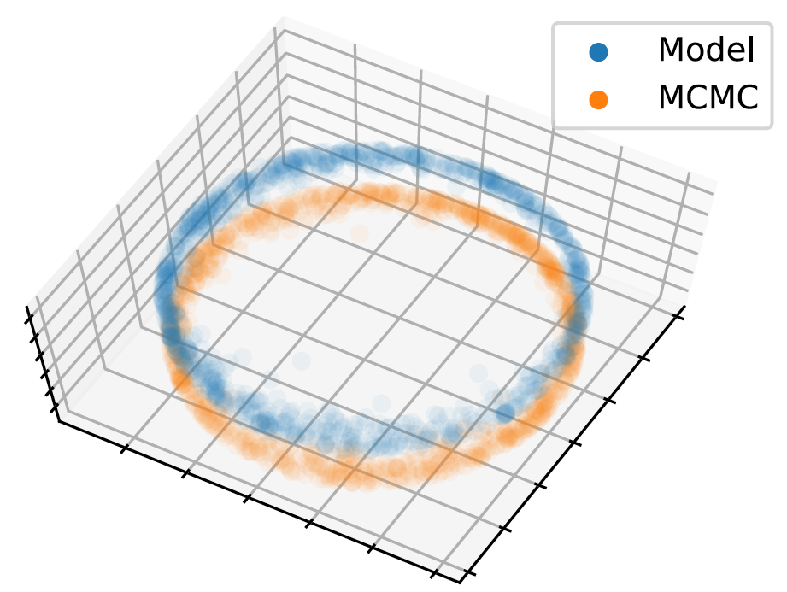
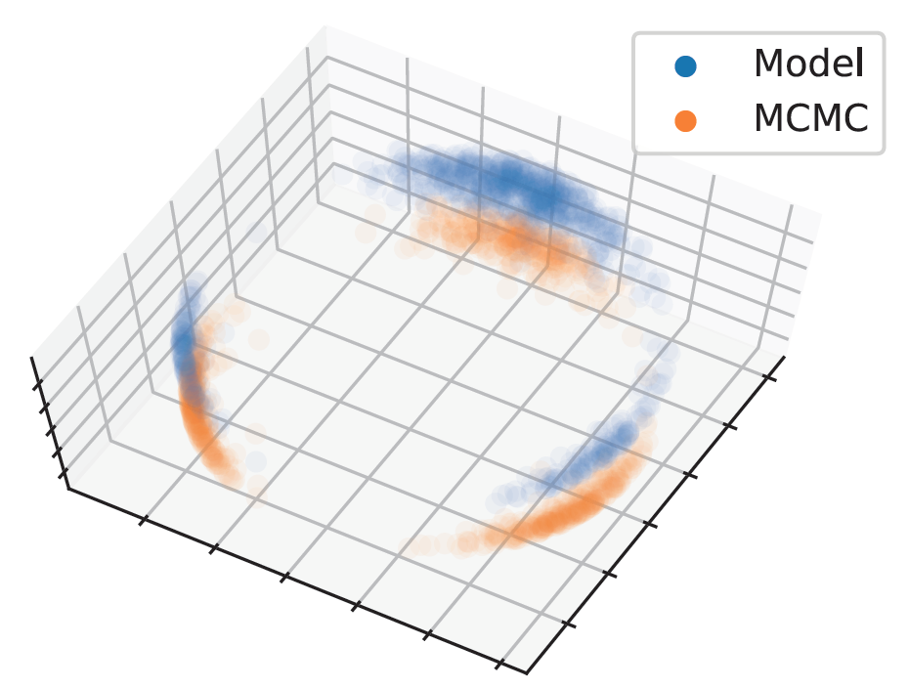
Results
(a)
(b)
Markov Chain Monte Carlo true posterior v. approximate model posterior
Modeled results are lifted in z-axis for clarity
Almost perfectly capture latent dynamics!
Notes:
i.e. the space that covers precily how i move this water bottle around
Many possible a priori rotations possible to end up at same image

Slide 19
Takeaway
Go beyond Euclidean spaces!
Easy to use framework for distributions on all Lie Groups
Can express powerful multimodal distributions
Usable for:
Variational Inference
Maximum Likelihood Estimation
(For technical details + lively discussion: visit our Poster #We116 later today!)

Slide 20
Thank You for your Time!
Contact: luca.falorsi@aiconic.com pimdehaan@gmail.com tim.davidson@aiconic.com

